Slide 1

WELCOME
TO
GREEN-A-THON
PRESENTED BY
MISS. SAMIKSHA DASHORA
MR. DAKSH JAIN
MR. VISHNU DESHANTRI
MR. ABHISEKH SETH

Slide 2

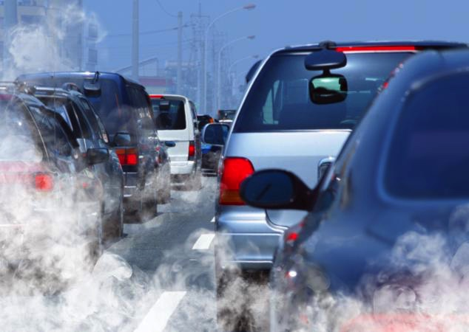
AIR POLLUTION
Air pollution refers to the condition in which the existence of toxic substances in the atmosphere, generated by various human activities and natural phenomena.

Slide 3
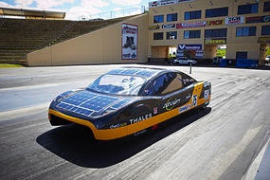
SOLAR CAR
A solar car is a solar vehicle used for land transport. Solar cars are usually run on only power from the sun, although some models will supplement that power using a battery, or use solar panels to recharge batteries or run auxiliary systems for a car that mainly uses battery power.

Slide 4
Solar cars combine technology typically used in the aerospace, alternative energy and automotive industries. The design of a solar vehicle is severely limited by the amount of energy input into the car. Most solar cars have been built for the purpose of solar car races. Some prototypes have been designed for public use, although no cars primarily powered by the sun are available commercially.
Solar cars depend on a solar array that uses photovoltaic cells (PV cells) to convert sunlight into electricity. Unlike solar thermal energy which converts solar energy to heat, PV cells directly convert sunlight into electricity. When sunlight (photons) strike PV cells, they excite electrons and allow them to flow, creating an electric current. PV cells are made of semiconductor materials such as silicon and alloys of indium, gallium and nitrogen. Crystalline silicon is the most common material used and has an efficiency rate of 15-20%.

Slide 5

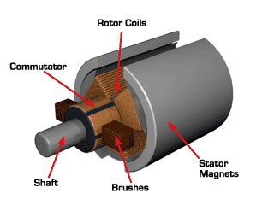
SOME BASIC FEATURES
Batteries:
The battery pack in a typical solar car is
sufficient to allow the car to go 250 miles
(400 km) without sun, and allow the car to continuously travel at speeds of 60 mph
(97 km/h).
Motors:
The motors used in solar cars typically about
2 or 3 horsepower, yet experimental light
solar cars may attain the same speed as a
typical family car (100 mph (160 km/h)).

Slide 6

Air Pollution And Nanotechnology
There are two major ways in which nanotechnology is being used to reduce air pollution: catalysts, which are currently in use and constantly being improved upon; and nano-structured membranes, which are under development.

Slide 7
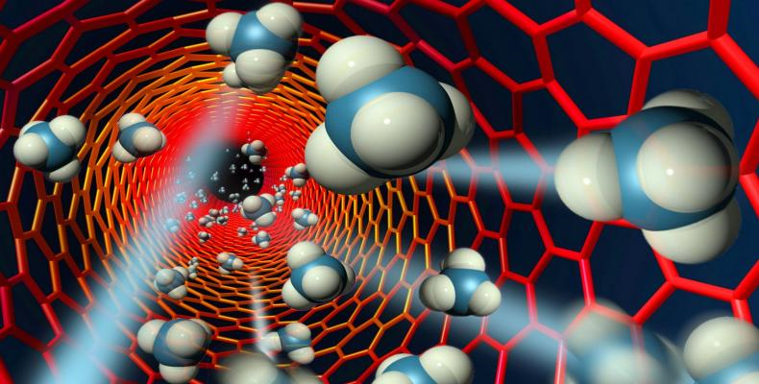
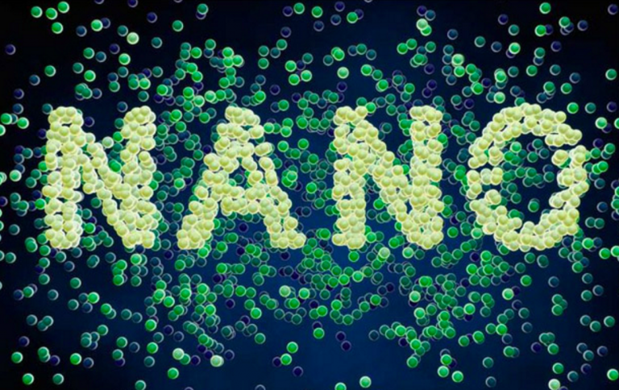
Catalysts can be used to enable a chemical reaction (which changes one type of molecule to another) at lower temperatures or make the reaction more effective. Nanotechnology can improve the performance and cost of catalysts used to transform vapours escaping from cars or industrial plants into harmless gasses. That's because catalysts made from nanoparticles have a greater surface area to interact with the reacting chemicals than catalysts made from larger particles. The larger surface area allows more chemicals to interact with the catalyst simultaneously, which makes the catalyst more effective.

Slide 8
APPLICATION UNDER DEVELOPMENT
Using gold nano particles embedded in a porous manganese oxide as a room temperature catalyst to breakdown volatile organic compounds in air.
Using crystals containing nanosized pores to trap carbon dioxide.
Using a nano catalyst containing cobalt and platinum to remove nitrogen oxide from smokestacks
Reducing the amount of platinum used in catalytic converters.
Converting carbon dioxide to methanol; which can be used to power fuel-cells.
Reducing emissions from power plants by converting carbon dioxide into nano tubes.
Removal of carbon dioxide from industrial smoke stacks using:
Carbon nano tube based membranes
Nano structured membranes
Genetically engineered enzymes

Slide 9
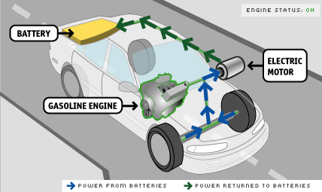
HYBRID VEHICAL
A hybrid vehicle uses two or more distinct types of power, such as internal combustion engine to drive an electric generator that powers an electric motor. e.g. in diesel-electric trains using diesel engines to drive an electric generator that powers an electric motor, and submarines that use diesels when surfaced and batteries when submerged. Other means to store energy include pressurized fluid in hydraulic hybrids.
The basic principle with hybrid vehicles is
that the different power sources work
better at different speeds and then
switching from one to the other at the
proper time during the speed transform
yields a win-win in terms of energy
efficiency, as such that translates into
greater fuel efficiency.

Slide 10
WORKING
Hybrids-Electric vehicles (HEVs) combine the advantage of gasoline engines and electric motors. The key areas for efficiency or performance gains are regenerative braking, dual power sources, and less idling.
Regenerate Braking- The drivetrain can be used to convert kinetic energy (from the moving car) into stored electrical energy (batteries). The same electric motor that powers the drivetrain is used to resist the motion of the drivetrain. This applied resistance from the electric motor causes the wheel to slow down and simultaneously recharge the batteries.
Dual Power. Power can come from either the engine, motor or both depending on driving circumstances. Additional power to assist the engine in accelerating or climbing might be provided by the electric motor. Or more commonly, a smaller electric motor provides all of the power for low-speed driving conditions and is augmented by the engine at higher speeds.Automatic Start/Shutoff. It automatically shuts off the engine when the vehicle comes to a stop and restarts it when the accelerator is pressed down. This automation is much simpler with an electric motor. Also see dual power above.

Slide 11


Slide 12
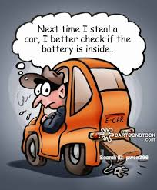
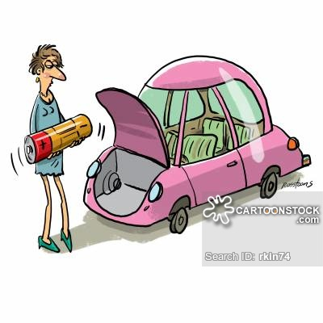
ENVIRONMENTAL IMPACT OF HYBRID CAR BATTERY
Though hybrid cars consume less fuel than conventional cars, there is still an issue regarding the environmental damage of the hybrid car battery.

Slide 13
HYBRID CAR BATTERY
nickel metal hydride
lithium ion

Slide 14
The toxicity levels and environmental impact of nickel metal hydride batteries—the type currently used in hybrids—are much lower than batteries like lead acid or nickel cadmium according to one source. Another source claims nickel metal hydride batteries are much more toxic than lead batteries, also that recycling them and disposing of them safely is difficult. In general various soluble and insoluble nickel compounds, such as nickel chloride and nickel oxide, have known carcinogenic effects in chick embryos and rats. The main nickel compound in NiMH batteries is nickel oxyhydroxide (NiOOH), which is used as the positive electrode.
.
.

Slide 15
HYBRID CAR BATTERY COMPARISION
NiMH | Li - Ion
Heavy weight. | Light weight.
Relative resistance to heat. | Sensitive to heat.
Rechargeable. | Non rechargeable.
Low energy density. | High energy density.
Required maintenance. | Do not required maintenance.
Mature technology. | Not fully mature technology.

Slide 16
THANK YOU

